Slide 1

Zeus: Understanding and Optimizing GPU Energy
Consumption of DNN Training
AGITHE YESHWANTH - MT25059

Slide 2
Background
DNN Training.
GPU: Training GPT-3 == 120 years of electricity for a average US household.
ETA (Energy-to-Accuracy)
TTA (Time-to-Accuracy)
ETA = TTA * AVGPower (Depends on Batch Size and Power Limit)

Slide 3
Motivation
Scale: AI models demand exponentially more compute and energy.
Impact: Training GPT-3 consumes 1,287 MWh—equal to 120 years of an average U.S. household's electricity.
Goal: Optimizing cluster-level efficiency saves costs and reduces massive carbon footprints.

Slide 4
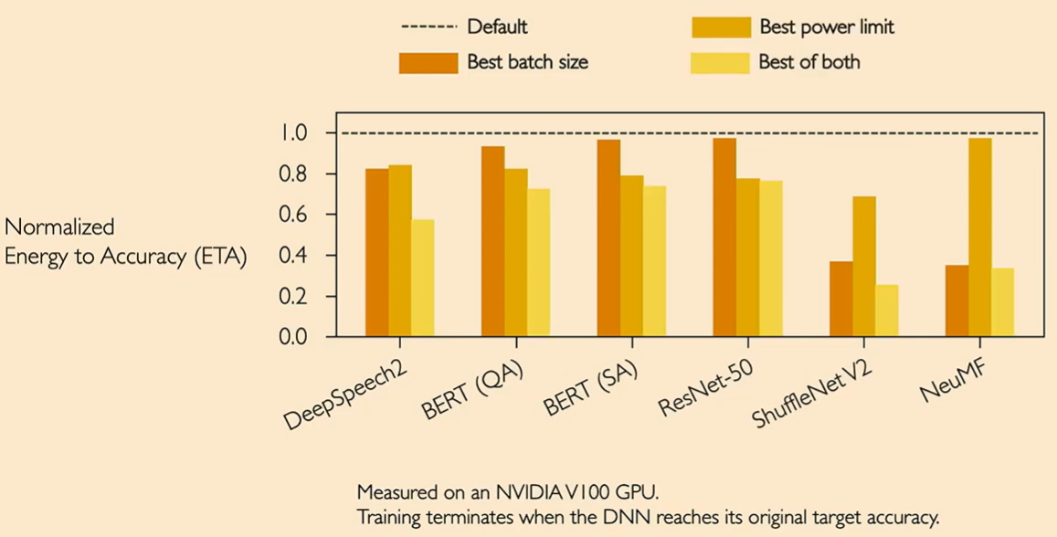
Opportunity for Energy Savings
Here we observe 24~75% of reduction

Slide 5
Existing Solutions are not Practically Enough.
🡪New energy-efficient DNN architectures.
Squeeze Next (CVPRW '18), ChamNet (CVPR '19), SkyNet (MLSys ‘20)
🡪New energy-efficient HW architectures.
TPU (ISCA '17), EDEN (MICRO '19), LNPU (ISSCC ‘19)
🡪Offline profiling and power model fitting and Confined to GPU power configuration knobs
MPC (HPCA '17), ODPP (CCGRID '20), GPOEO (TPDS '22)

Slide 6
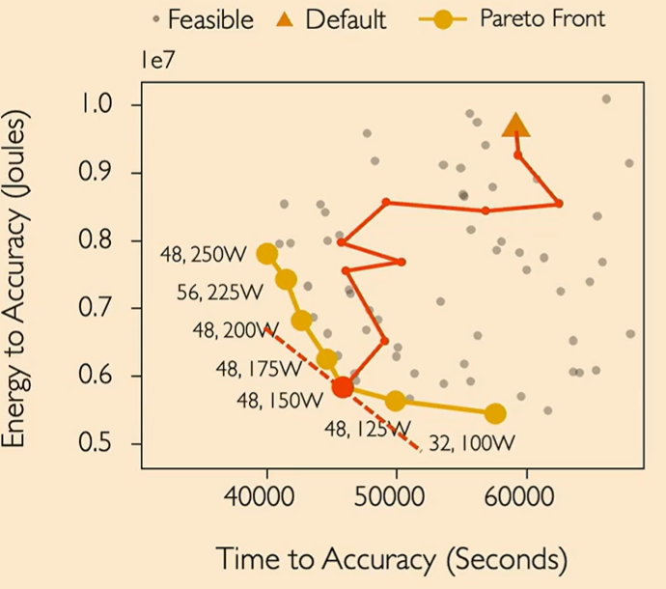
Relationship Between Time and Energy
🡪 Trade-off Between Time and Energy
🡪 Which point is the best?
Cost = η * ETA + (1- η )*MAXPOWER * TTA

Slide 7
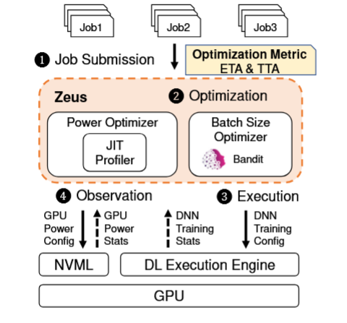
Zeus workflow

Slide 8
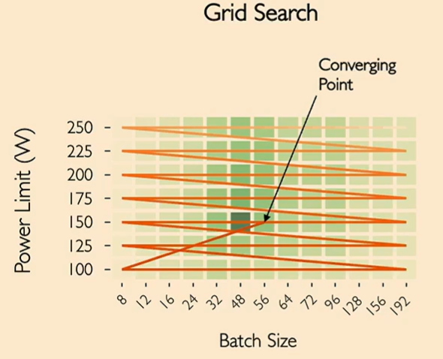
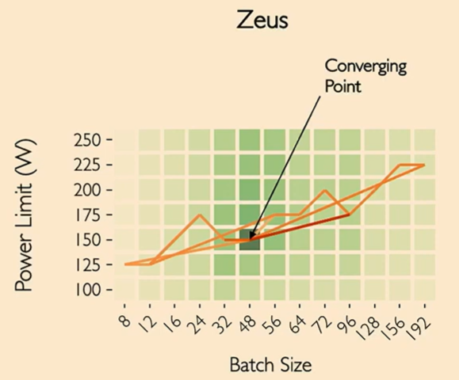
How Zeus reaches the converging point

Slide 9
Conclusion
🡪 Works on any DNN model.
🡪 Works without modifying Existing hardware.
🡪 Fully online JIT profiling and MAB.
🡪 Jointly optimizes both job and GPU –side configurations.

